Slide 1




From Click to Closet: Minimizing Returns to Maximize Revenue and Customer Loyalty
Presented by: Ankita Venkatesh Koli
(22f2001103)

Slide 2



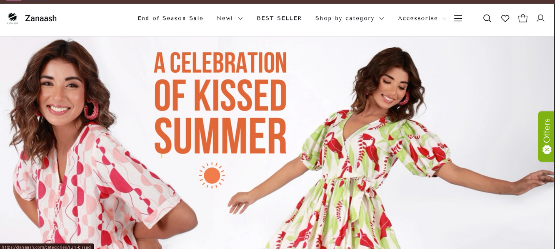
Organization Background
The brand ZANAASH, located at G-92, Ramanuj, Shyam Nagar Marg, Jaipur, Rajasthan 302019, is a prominent clothing brand renowned for its high-quality craftsmanship and premium products. Despite its strong reputation, the organization faces challenges in maximizing revenue generation and maintaining customer satisfaction due to delivery delays and underperforming product categories.

Slide 3


Delivery delays
The organization is facing inefficiencies in timely delivery, causing disruptions in service and lowering customer trust.
Problem Statement
The organization is struggling to boost revenue and maintain customer satisfaction. Key issues include delivery delays and Revenue growth in certain product categories. These challenges are threatening its market position and overall business success.
Customer Churn
Dissatisfied customers are leaving due to unmet expectations, directly impacting customer retention rates and overall revenue.
Revenue performance
Certain product categories are underperforming, failing to meet market demand or generate sufficient profit.

Slide 4



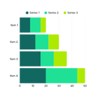

Data collection and Preparation
1
2
3
4
Tools and platforms used
Cleaning and preparation steps
Primary data sources
Data type and variable collected
Data collection was done by gathering data from internal order management system for 7 months from January - August. Key fields such as Order status, Order date, Delivery date, Order Quantity, Cancel remarks etc.
Python(Pandas, Matplotlib, Seaborn. Plotly).
Google Colab: For code execution and collaboration.
Excel: Initial inspection and handling of missing data.
Handled missing values
Standardized column names and removed irrelevant fields.
Derived new metrics: DeliveryTime = DeliveredDate - OrderDate, ReturnRate, RFM Score
Quantitative data
Categorical data
Date/Time data
cleaned data : https://docs.google.com/spreadsheets/d/11_yTy3eFq1EMCkyvWUAglGElCREDdtCQ2sJbZxWSEsg/edit?usp=sharing

Slide 5









Methodology
The methodology involved structured data cleaning, exploratory data analysis (EDA) to uncover key patterns and trends before any modeling or strategic decisions., correlation analysis, customer segmentation using RFM and clustering, and product efficiency evaluation to derive actionable insights from the Zanaash e-commerce dataset.
Data handling and preprocessing using EDA
Interpretations
Data collection
Analysis
Recommendation

Slide 6
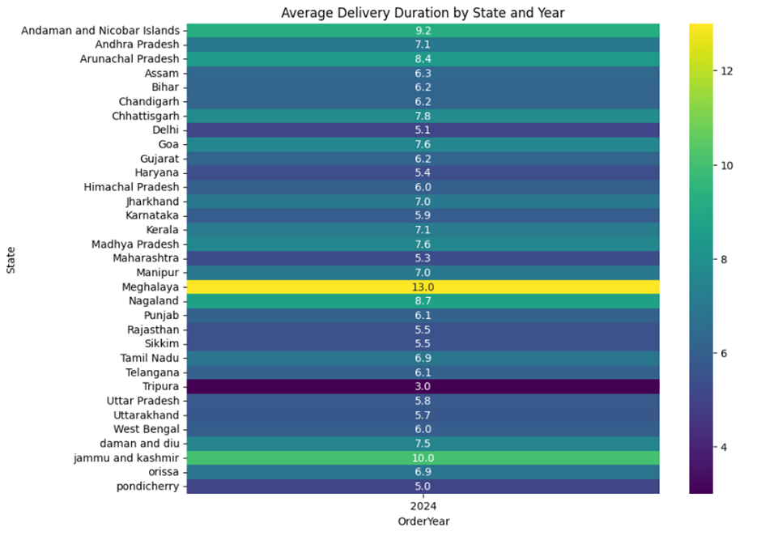
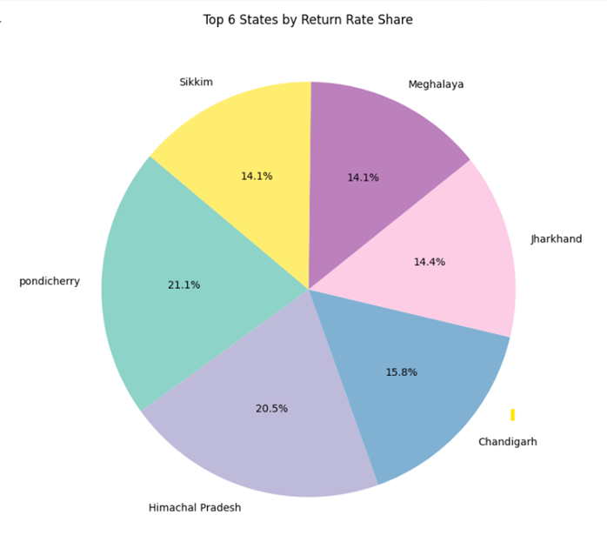

Returns Analysis
Common reasons for cancellations include customer refusal, late delivery, and address-related issues.
This highlights the need to optimize delivery timelines and improve address verification to reduce returns and cancellations.
These states were correlated with these regions that also show higher cancellation and return behaviour.
suggesting geographically localized fulfilment inefficiencies or misalignment between product offering and customer expectations in those regions.
Pondicherry and Himachal Pradesh with return rates exceeding 70% should be prioritized for operational review.
Average Delivery Duration using heatmap
Top state Return analysis

Slide 7

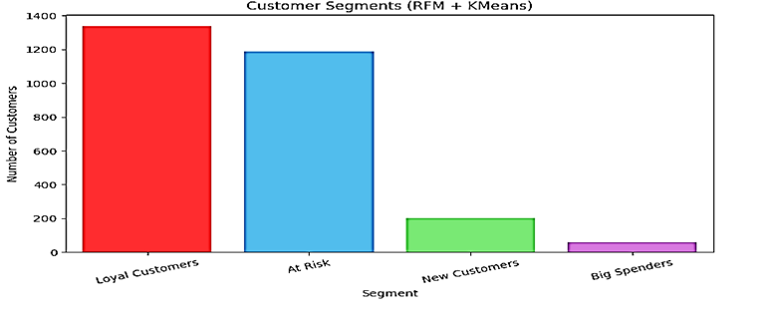

Customer Segmentation analysis
Most Loyal customers
At RIsk
Steady and engaged customers
One time / Dormant customer
They buy often but haven’t done so recently.
These are most profitable and loyal customers
These are new customers with good potential
Not super recent, but spends a lot.

Slide 8
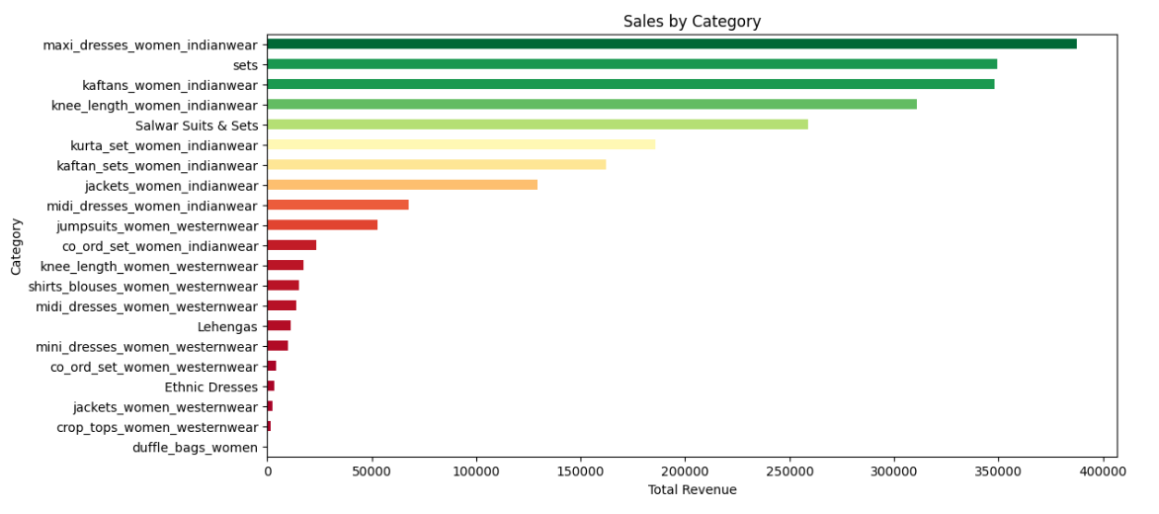
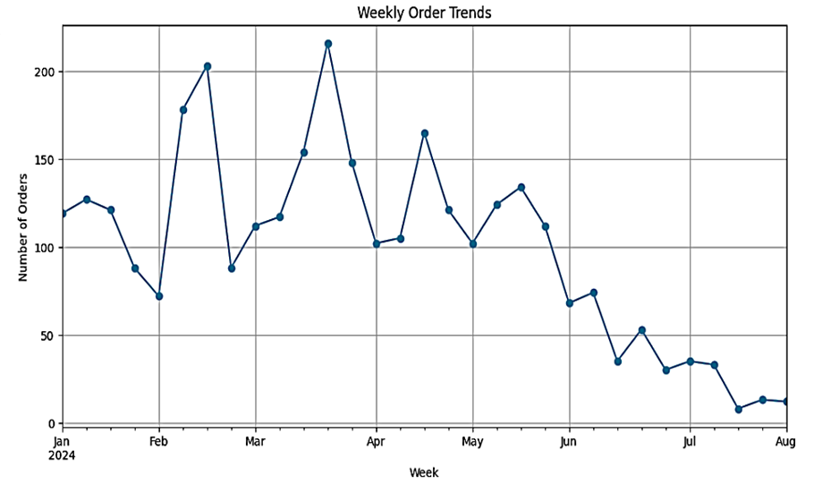
Revenue Growth analysis
The total sales across all categories amount to Rs 4,388,932.97, reflecting the customer demand across the product line.
The most sales were from Maharashtra, U.P,
Analyzing the category-wise contribution reveals trends and insightful patterns about customer preferences towards Indian wear in Maxi dresses, Kaftans, and sets.
The least contribution comes from Duffle bags, jackets and ethnic wear.
Time series analysis
Orders started strong in Jan, dipped in early Feb, then spiked in late Feb–Mar due to promotions.
Peak orders (215+) seen in late Mar/early Apr, likely from summer and wedding season push.
May saw a gradual decline; June dropped sharply below 100 orders/week.
July–Aug hit the lowest (30–50/week) due to seasonal slowdown and fewer new arrivals.

Slide 9

Recommendations
Order Issues: High cancellations from address/product errors & delays are solved by fixing with address verification, stock visibility, and dispatch checks.
Supply Chain: Weekend spikes cause delays – scale staffing & warehouse operations from Thursday - Sunday to match order trends.
Seasonality: Peak in March-April, plan campaigns here; injecting flash sales mid-year (May–June) to offset dips.
Pricing Strategy: Use dynamic pricing by giving discounts on elastic items like kaftans, cords-sets, maxi dresses, and Indian wear and increasing prices on inelastic essentials to boost margins.
Customer Targeting: Focus on high-value segments with personalized offers, loyalty perks & win-back campaigns

Slide 10
THANK YOU

